Slide 1
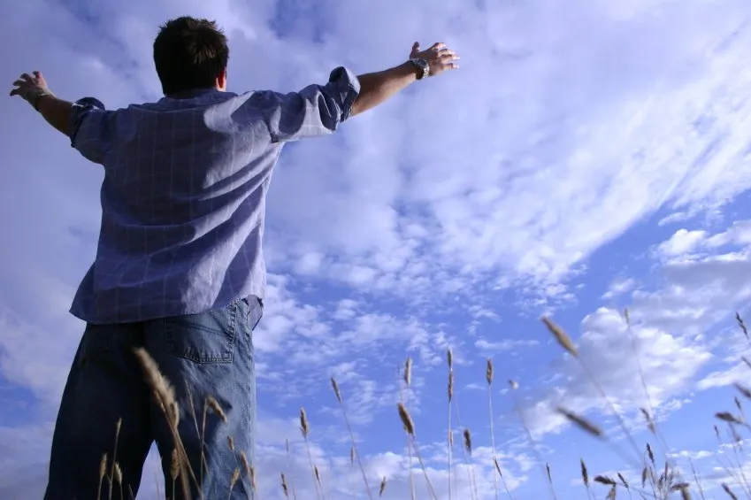
The purpose and goal of every Christian
PHILIPPIANS 3:10-14
¹⁰ I want to know Christ—yes, to know the power of his resurrection and participation in his sufferings, becoming like him in his death, ¹¹ and so, somehow, attaining to the resurrection from the dead.
¹² Not that I have already obtained all this, or have already arrived at my goal, but I press on to take hold of that for which Christ Jesus took hold of me. ¹³ Brothers and sisters, I do not consider myself yet to have taken hold of it. But one thing I do: Forgetting what is behind and straining toward what is ahead, ¹⁴ I press on toward the goal to win the prize for which God has called me heavenward in Christ Jesus.

Slide 2
I. RELATIONSHIP IS MORE IMPORTANT THAN ACCOMPLISMENT (V. 10)
¹⁰ I want to know Christ—yes, to know the power of his resurrection and participation in his sufferings, becoming like him in his death,

Slide 3
THAT I MAY KNOW HIM

Slide 4
I. RELATIONSHIP IS MORE IMPORTANT THAN ACCOMPLISMENT (V. 10)
* TO KNOW THE LORD PERSONALLY
* TO KNOW THE LORD POWERFULLY
* TO KNOW THE LORD PASSIONATELY
¹⁰ I want to know Christ—yes, to know the power of his resurrection and participation in his sufferings, becoming like him in his death,

Slide 5
II. SATISFACTION IN LIFE MAY MEAN YOU TO AIMED LESS.
¹² Not that I have already obtained all this, or have already arrived at my goal, but I press on to take hold of that for which Christ Jesus took hold of me.

Slide 6
* Do not be satisfied with your present condition
.
* Every Christian should be a growing believer

Slide 7
YOU ARE NEVER A FAILURE UNTIL YOU QUIT GROWING
.

Slide 8
Apostle Paul never stop running the race
.

Slide 9
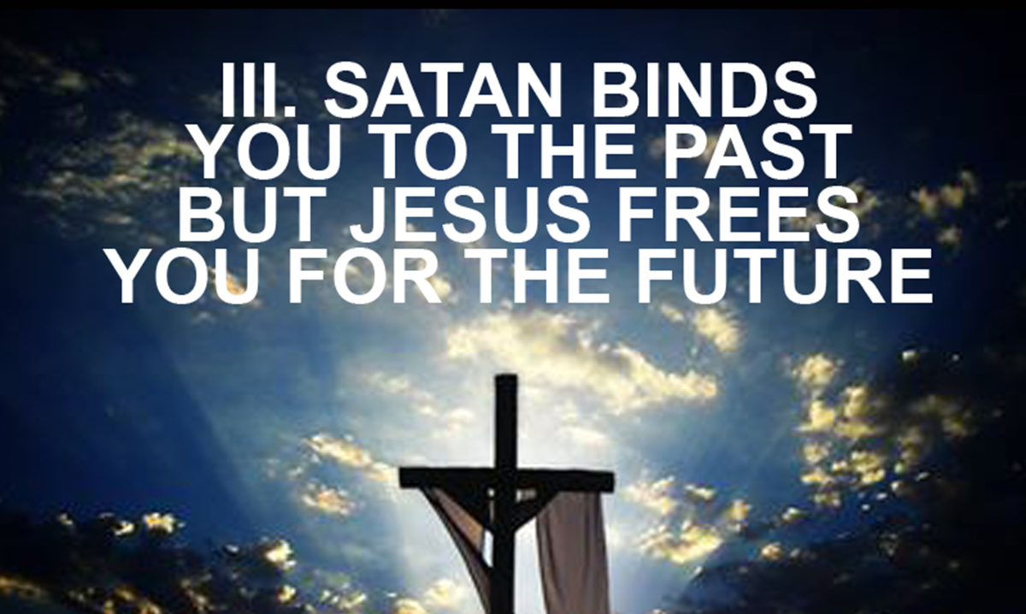
“Forgetting those things which are behind (the past) and reaching forward to those things which are ahead (the future)” Phil. 3:13-14

Slide 10
“Forgetting those things which are behind (the past) and reaching forward to those things which are ahead (the future)”
Phil. 3:13-14
FORGET PAST GUILT
FORGET PAST GLORY
FORGET PAST GRIEF
FORGET PAST GRUDGES
FORGET PAST FAILURES

Slide 11
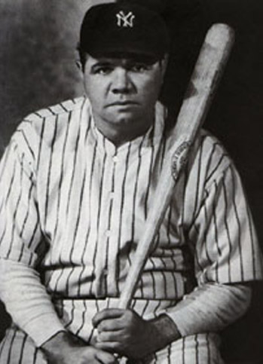
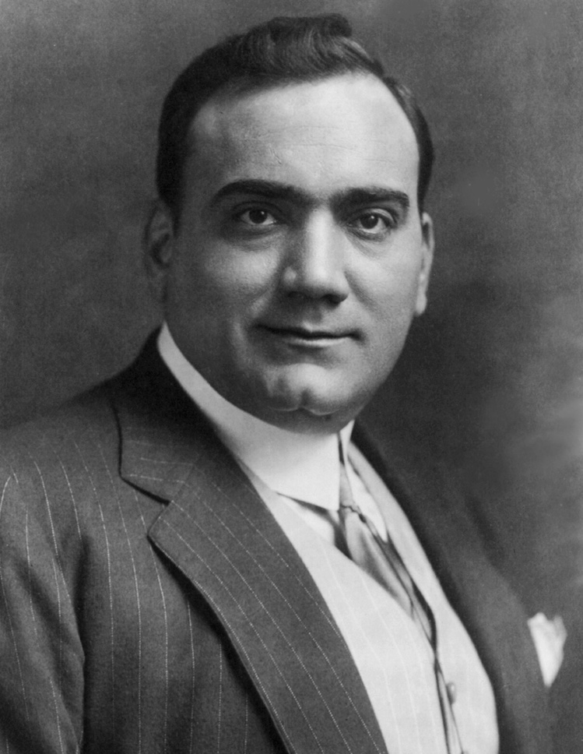
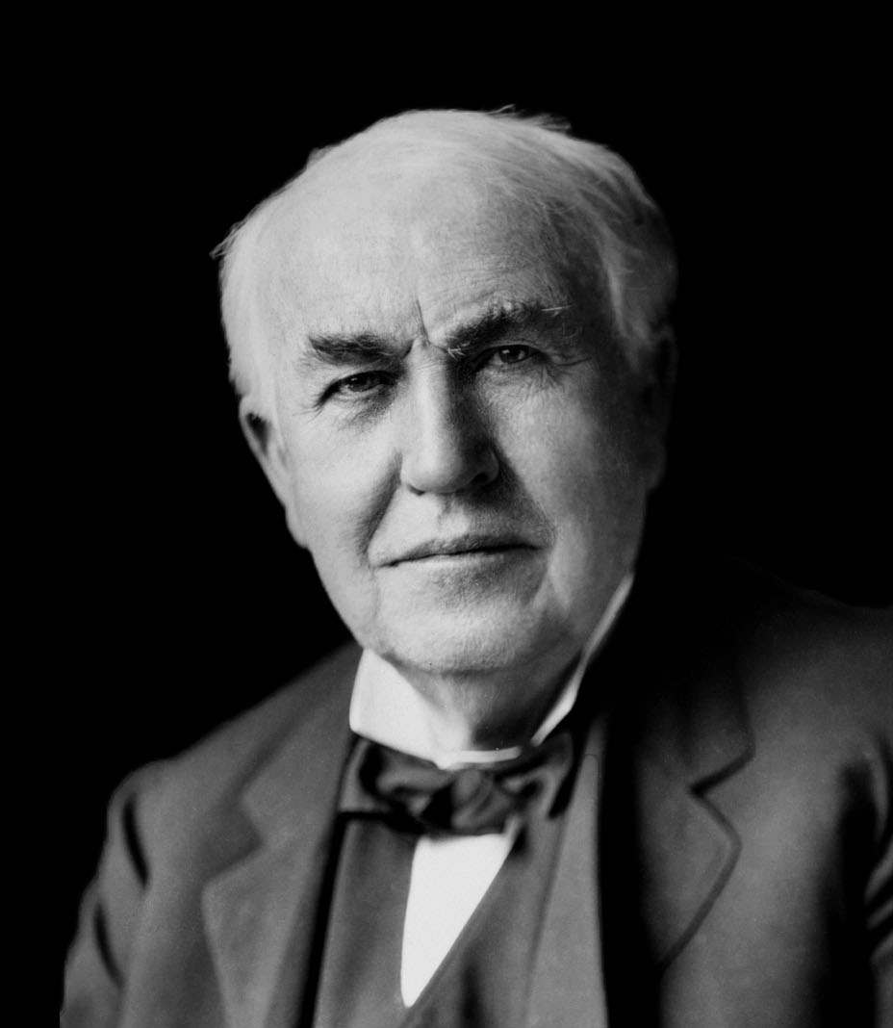
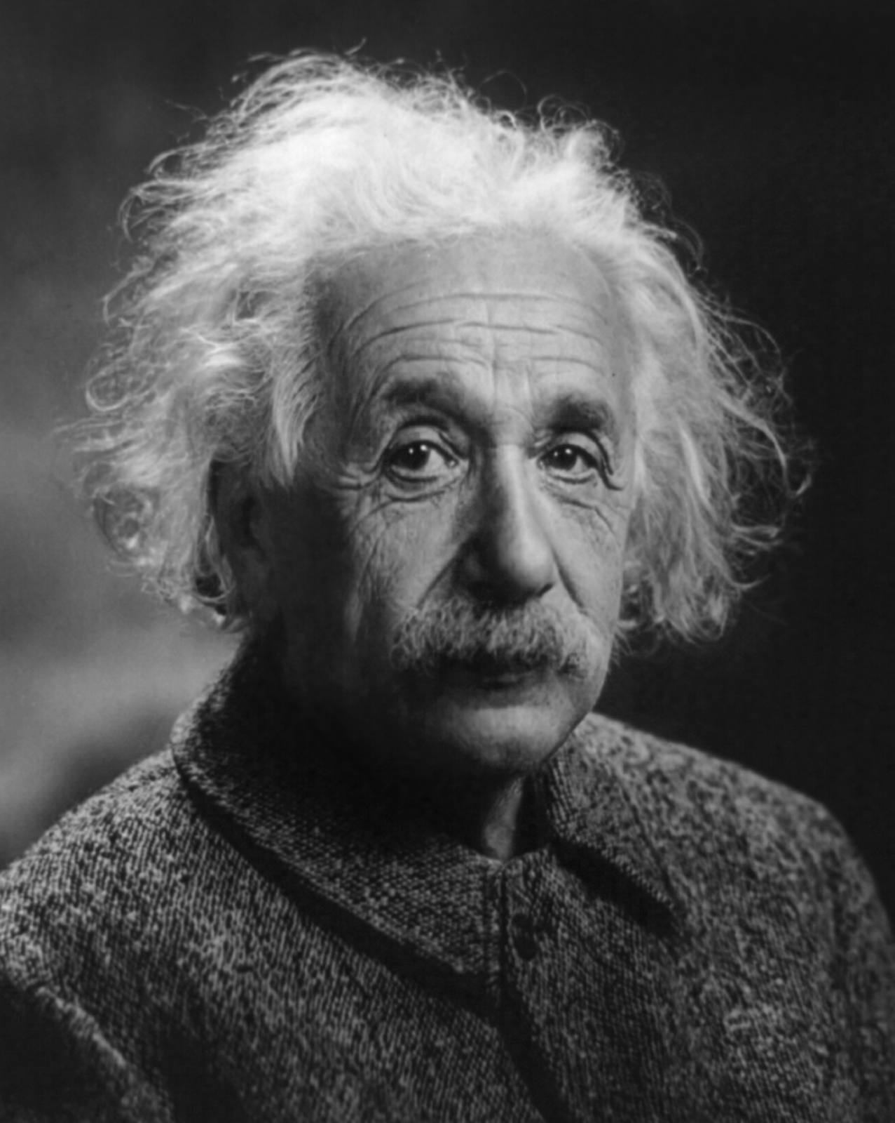
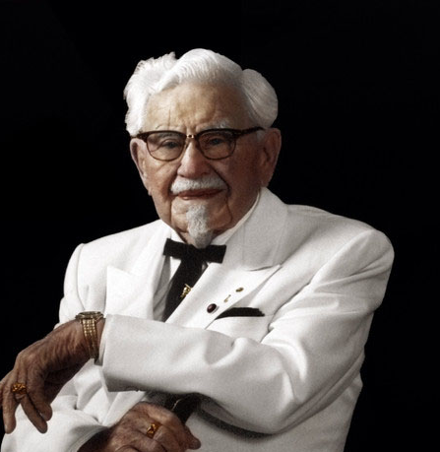
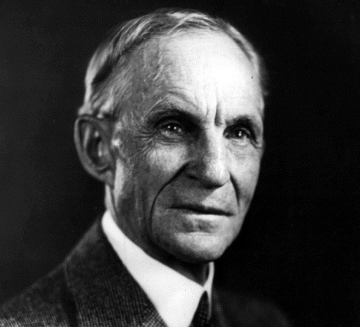
BABE RUTH
ENRICO CARUSO
THOMAS EDISON
ALBERT EINSTEIN
HENRY FORD
COLONEL SANDERS
Notes:
(ILL/APP) BABE RUTH – BASEBALL
MORE STRIKE OUTS BUT KNOWN A HOME RUN KING
CARUSO THE GREATEST TENOR OF ALL TIMES… MUSIC TEACHER SAID HE SHOULD QUIT – COULD NOT HIT THOSE NOTES.
THOMAS EDISSON – HIS TEACHER CALLED HIM DUMB BUT HIS MOTHER SAID MY SON IS NOT STUPID. I’LL TEACH HIM MYSELF
ALBERT EINSTEIN – FLUNKED MATHEMATICS
HENRY FORD – WAS PENNILESS AND BROKE AT 40 YRS OLD, BUT HE REFUSED TO BE FETTERED BY FAILURE
COL SANDERS – AT 65 YRS OLD HE COULD NOT SELL HIS CHICKEN RECIPE TO 300 PLUS PEOPLE, BUT HE WOULD NOT BE FETTERED BY FAILURES.

Slide 12
SATAN WANTS TO CHAIN US TO THE PAST BUT JESUS FREES US FOR THE FUTURE!

Slide 13
IV.FOCUSYOUR FAITH
ON JESUS
¹⁴ I press on toward the goal to win the prize for which God has called me heavenward in Christ Jesus.

Slide 14
HOW DO WE FOCUS OUR FAITH AS WE RUN THE RACE?
DESIRE
We must narrow
all our interest
into one

Slide 15
HOW DO WE FOCUS OUR FAITH AS WE RUN THE RACE?
We must focus our heart’s desire to Jesus
Matthew 6:24
James 1:8
Hebrews 12:2
Notes:
Matthew 6:24 New King James Version (NKJV)
²⁴ “No one can serve two masters; for either he will hate the one and love the other, or else he will be loyal to the one and despise the other. You cannot serve God and mammon.
James 1:8 New King James Version (NKJV)
⁸ he is a double-minded man, unstable in all his ways
Hebrews 12:2 New King James Version (NKJV)
² looking unto Jesus, the author and finisher of our faith, who for the joy that was set before Him endured the cross, despising the shame, and has sat down at the right hand of the throne of God.

Slide 16
HOW DO WE FOCUS OUR FAITH AS WE RUN THE RACE?
DISCIPLINE
I follow after” (v.12)
“I press toward the
goal” (v.14)
Notes:
DISCIPLINE-THESE WORDS MEAN “TO RELENTLESSLY PURSUE, TO CHASE AFTER”
(FN) APP/ILL: ATHLETE
Discipline in the area of our appetites
Discipline in our choice of friends
Discipline in our use of time, energy and resources
James 1:8 New King James Version (NKJV)
⁸ he is a double-minded man, unstable in all his ways

Slide 17
HOW DO WE FOCUS OUR FAITH AS WE RUN THE RACE?
DIRECTION
You need to keep your eyes on the goal

Slide 18
JESUS, HIS CALL UPON OUR LIFE IS THE ULTIMATE PURPOSE & GOAL
OF OUR CHRISTIAN LIFE!
Notes:
(FN) ILL/APP
IN DALLAS, A YOUNG LADY, A DEBUTANTE WAS RAISED IN A VERY WEALTHY FAMILY. HER DAD MADE TONS OF MONEY… HE WAS PROUD OF HER DAUGHTER AND HAD BIG PLANS FOR HER. THE GIRL WAS AN ACCOMPLISHED PIANIST. SOMEONE INVITED THIS YOUNG SOCIALITE TO A REVIVAL CRUSADE. SHE RECEIVED JESUS CHRIST THEN TOLD HER DAD… WHO BECAME ENRAGED. GAVE HER UNTIL 10AM THE NEXT MORNING TO RENOUNCE HER FAITH IN CHRIST OR WILL BE DISINHERITED AND WOULD NO LONGER BELONG TO THE FAMILY… AT 9:55AM – SHE WENT DOWN THE BEAUTIFUL STAIRCASE… PLAYED ON THE PIANO AND SING THIS:
“JESUS, I MY CROSS HAVE TAKEN ALL TO LEAVE AND FOLLOW THEE. DESTITUTE, DESPISED, FORSAKEN THOU FROM HENCE MY ALL SHOULD BE PERISH EVERY FOND AMBITION ALL I’VE SOUGHT OR HOPED OR KNOWN. YET HOW RICH IS MY CONDITION! GOD AND HEAVEN ARE STILL MINE OWN” (HENRY F. LYLE)
I’d rather have Jesus than silver or gold;
I’d rather be His than have riches untold;
I’d rather have Jesus than houses or lands;
I’d rather be led by His nail-pierced hand Refrain:
Than to be the king of a vast domain
And be held in sin’s dread sway;
I’d rather have Jesus than anything
This world affords today.
I’d rather have Jesus than men’s applause;
I’d rather be faithful to His dear cause;
I’d rather have Jesus than worldwide fame;
I’d rather be true to His holy name
WHEN HER DADDY HEARD THAT, THE TEARS BEGAN TO FOLLOW AND WALK OVER AND HUGGED HIS BEAUTIFUL DAUGHTER TO LOVED SO MUCH AND SAID:
“SWEETHEART, IF JESUS MEANS THAT MUCH TO YOU, I NEED TO KNOW HIM TOO!”
THE APOSTLE PAUL “THAT I MAY KNOW HIM”

Slide 19
I’d rather have Jesus than silver or gold;
I’d rather be His than have riches untold;
I’d rather have Jesus than houses or lands;
I’d rather be led by His nail-pierced hand
Refrain:
Than to be the king of a vast domain
And be held in sin’s dread sway;
I’d rather have Jesus than anything
This world affords today.
I’d rather have Jesus than men’s applause;
I’d rather be faithful to His dear cause;
I’d rather have Jesus than worldwide fame;
I’d rather be true to His holy name

